Slide 1

Automotive Technology: A Systems Approach, 8e
Chapter 21: Instrumentation and Information Displays
Rob Thompson and Jack Erjavec, Automotive Technology: A Systems Approach, 8th Edition. © 2025 Cengage. All Rights Reserved. May not be scanned, copied or duplicated, or posted to a publicly accessible website, in whole or in part.

Slide 2
Chapter Objectives (1 of 2)
21.01 Explain the components and functions of the instrument panel.
21.02 Describe the types of displays used in modern vehicles.
21.03 Know the purpose of the various gauges used in today’s vehicles and how they function.
21.04 Describe the operation of the common types of gauges found in an instrument cluster.

Slide 3
Chapter Objectives (2 of 2)
21.05 List and explain the function of the various indicators found on today’s vehicles.
21.06 List and explain the function of the various warning devices found on today’s vehicles.
21.07 Explain the basics for diagnosing a gauge or warning circuit.
21.08 Explain the types and functions of driver information displays.

Slide 4
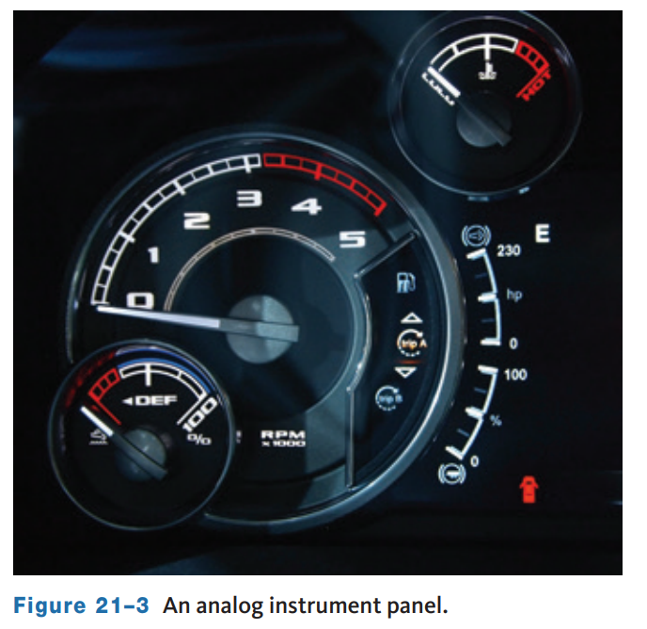
Instrument Panels (1 of 4)
21.01 Explain the components and functions of the instrument panel.
The displays on an instrument panel (IP) have many purposes, the most important of which are showing the status of current engine and vehicle information.
In an analog display, an indicator moves in front of a fixed scale to indicate a condition.
  The indicator is often a needle, but it can also be a liquid crystal or graphic display.
  They are best for things like RPM.
A digital display is better for showing exact, real-time data, but is difficult to quickly observe because it is constantly changing.
Many speedometer–odometer combinations are examples of both analog (speed) and digital (distance).

Slide 5
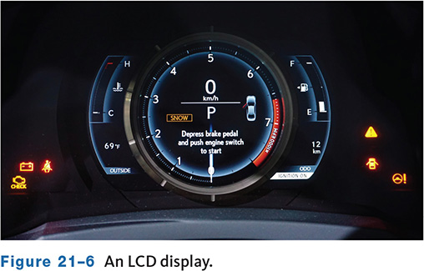
Instrument Panels (2 of 4)
Liquid Crystal Diode (LCD) displays are made of sandwiches of special glass and liquid.
A separate light source is required to make the display work.
When there is no voltage, light cannot pass through the fluid.
When voltage is applied, the light passes that point of the display.
With older screens, the action of LCDs may slow down in cold weather. Modern LCDs offer high definition curved glass displays.
These displays are also very delicate and must be handled with care.
Any rough handling of the display can damage it.

Slide 6
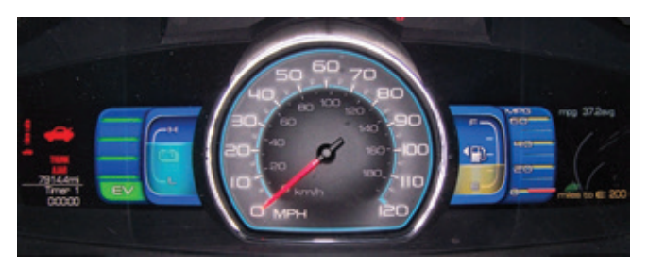
Instrument Panels (3 of 4)
Thin-Film-Transistor (TFT) LCD
  TFT displays improve the image quality over that of an LCD by actively controlling each pixel with a transistor.
  TFT displays offer greater display options and contrast and are used extensively as dash and infotainment displays.
  This type of screen often has separate sections that the driver can configure to show certain information.

Slide 7
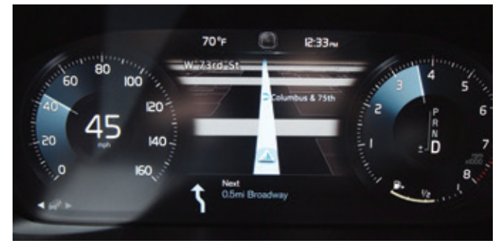
Instrument Panels (4 of 4)
Many of today’s vehicles are incorporating organic LED (OLED) screens into the instrument panels.
With OLED technology, each pixel provides its own illumination, eliminating the need for any backlighting.
This provides better color resolution and contrast as the black from OLEDs is superior to LCD or TFT screens.
OLED screens can also curve with the shape of the vehicle’s dashboard as they can be attached to a plastic substrate instead of glass.
A term that has become common regarding instrument panels is “glass dash,” which refers to the trend by automakers to replace mechanical gauge assemblies with digital display screens.

Slide 8
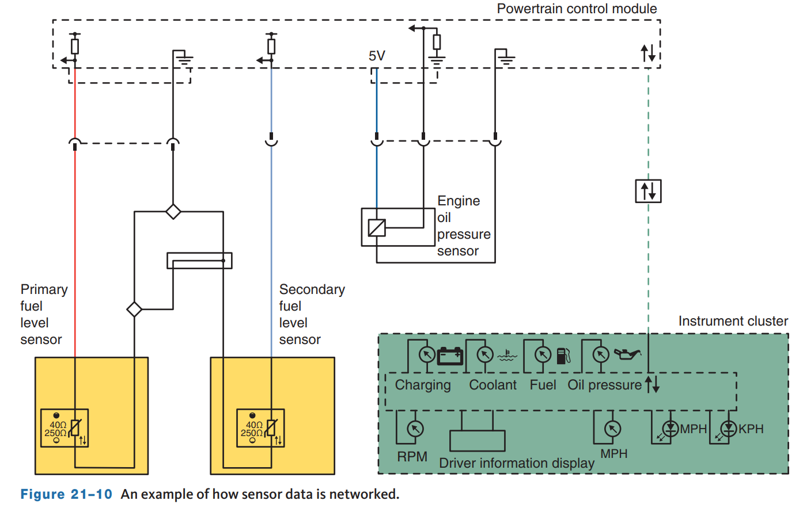
Mechanical Gauges (1 of 4)
21.03 Know the purpose of the various gauges used in today’s vehicles and how they function.
Gauges provide the driver with a scaled indication of the condition of a system.
All gauges require an input from either a sending unit, sensor, switch, or module.
With sending or sensor units, a change or movement made by an external component causes a change in electrical resistance.
Movement may be caused by pressure against a diaphragm, by heat, or by the motion of a float.
Some engines use a switch as an input for a gauge such as an oil pressure switch.

Slide 9
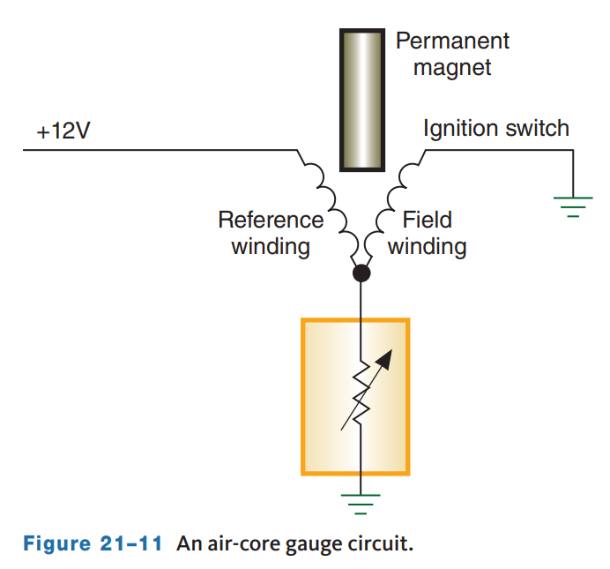
Mechanical Gauges (2 of 4)
Today, the most commonly used gauge is the air-core gauge.
The needle of the gauge is attached to the permanent magnet.
The electromagnetic windings do not have a metal core; rather the permanent magnet is placed inside the windings.
One of these windings is a reference winding and receives battery voltage at all times.
The other winding, called the field winding, is placed at an angle to the reference winding.
When current flows through the coils, their magnetic fields superimpose and the magnet is free to align with the combined fields.
The amount of movement is controlled by the resistance of the sending unit.

Slide 10
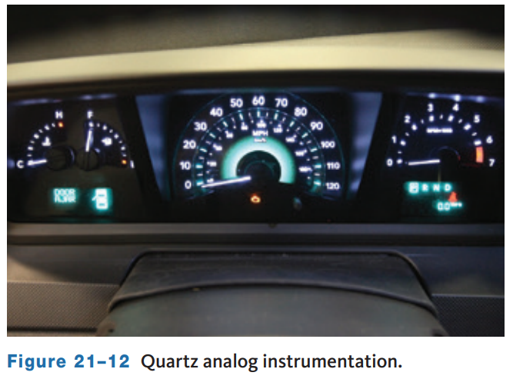
Mechanical Gauges (3 of 4)
Computer-controlled quartz analog gauges are becoming increasingly common.
These gauge circuits rely on a permanent magnet generator sensor installed in the part or system that will be monitored.
As the sensor rotates, a small AC signal is produced.
This signal is then sent to a buffer circuit where it is changed to a digitalized signal.
That signal is then sent to a quartz clock circuit and a driver circuit.
The driver circuit sends voltage pulses to the windings in the gauge.
The permanent magnet and the windings cause the needle to move.

Slide 11
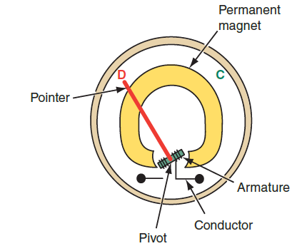
Mechanical Gauges (4 of 4)
There are several types of magnetic gauges, the simplest form is the ammeter type in which a permanent magnet attracts a ferrous indicator needle connected to a pivot point and holds it centered on the gauge.
An armature, or coil of wire, is wrapped around the base of the needle near the pivot point.
When current flows through the armature, a magnetic field is formed.
This magnetic field opposes that of the permanent magnet. Attractive or repulsive magnetic forces cause the needle to swing left or right.
The direction the needle swings depends on the direction of current flow in the armature.
This type of gauge is often referred to as a D’Arsonval gauge.

Slide 12
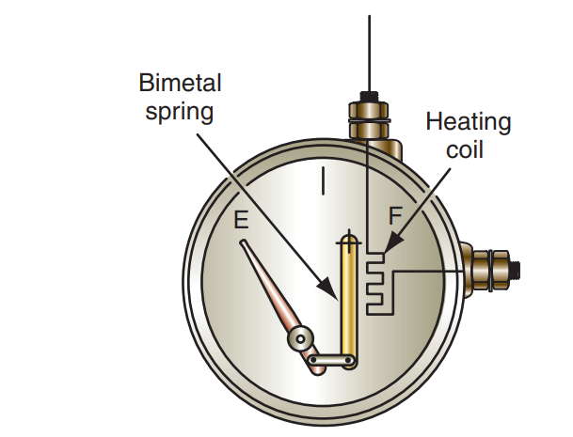
Thermal or Bimetallic Gauge
A bimetallic or thermal gauge operates through heat created by current flow.
A variable-resistance sending unit causes different amounts of current to flow through a heating coil within a gauge.
The heat acts on a bimetallic spring attached to a gauge needle.
When more heat is created, the needle swings farther up the scale.

Slide 13
Discussion
Instrumentation and information displays have evolved substantially since the introduction of LCD, TFT, and OLED technologies.
Have a class discussion about how these technologies are being used to provide more or better information and what types of other advantages they may offer in the future?

Slide 14
Electronic Instrument Clusters (1 of 2)
21.04 Describe the operation of the common types of gauges found in an instrument cluster.
Many of the displays on an instrument panel are controlled by the same sensors used to control the vehicle’s powertrain and other systems.
The signals from the sensors are part the multiplex system, in which the inputs are used by many systems.
The routing of the input signals can be handled by the body control module (BCM) which may also be capable of running diagnostic checks on the instrument panel.
If any of the input or output signals are out of the normal range, the BCM will set a DTC.
The code is typically retrieved with a scan tool.
Most instrument panel display modules have a self-diagnostic mode.
This mode allows the module to isolate faults in the cluster; when this test is initiated, all components and circuits are checked.

Slide 15
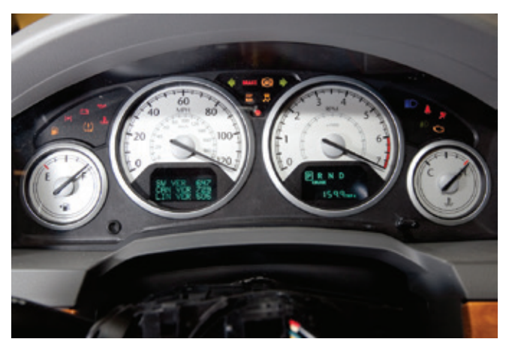
Electronic Instrument Clusters (2 of 2)
Nearly all electronic instrument panels have a prove-out display.
This display occurs each time the ignition switch is turned on.
During this mode, all segments of the instrument display are illuminated and then momentarily turned off.
Then the display should return to normal.
If the instrument panel did not illuminate, check for power to the panel and the panel’s ground.
If both of these are good, replace the cluster.
If some of the segments or parts of the display do not illuminate, replace the cluster.

Slide 16
Basic Information Gauges (1 of 3)
21.07 Explain the basics for diagnosing a gauge or warning circuit.
Diagnosis should begin with a good visual inspection of the circuit.
Check all sensors and actuators for physical damage.
Check all connections to sensors, actuators, control modules, and ground points.
Check the wiring for signs of burned or chafed spots, pinched wires, or contact with sharp edges or hot exhaust parts.
After completing the visual checks, use a scan tool to retrieve any DTCs and monitor the data stream as necessary.
Many systems provide testing the operation of instrument panel gauges and warning lights with a scan tool.
Always refer to the manufacturer’s recommended procedure before beginning to diagnose a circuit.

Slide 17
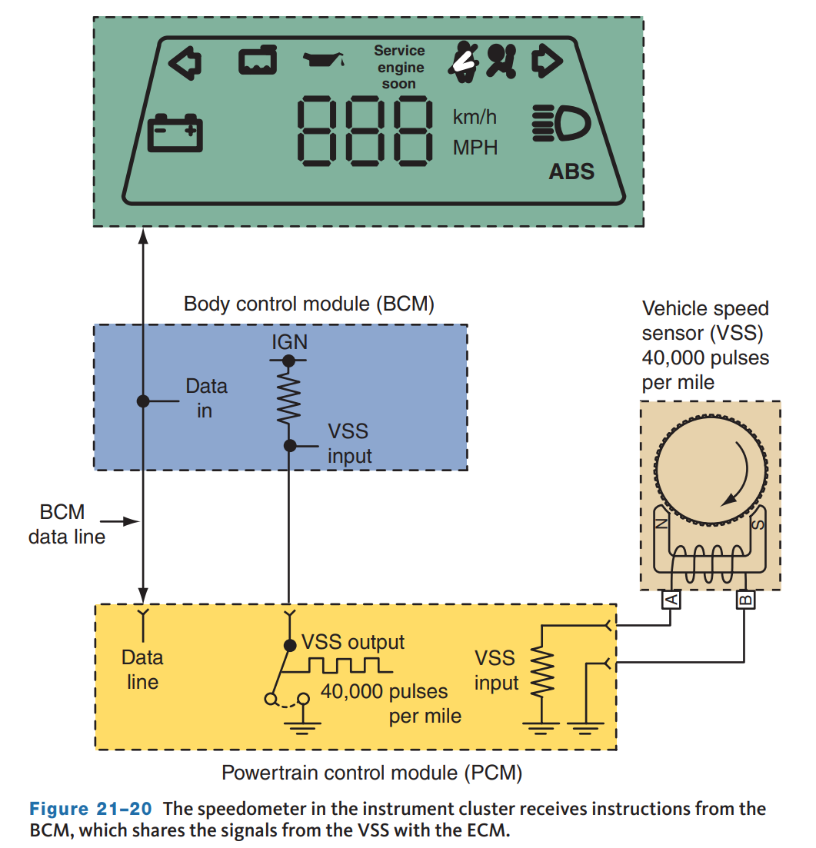
Basic Information Gauges (2 of 3)
In the past, the speedometer was a nonelectrical or mechanical gauge.
It had a drive cable attached to a gear in the transmission that turned a magnet inside a cup-shaped metal piece at the gauge.
As the cable rotated faster with increased speed, magnetic forces acted on the cup forcing it to move.
As a result, the needle moved up and down the speed scale.
Electric speedometers are used in all late model vehicles.
While there are several systems in use, one of the most common types receives its speed information from ABS system or from the transmission-mounted vehicle speed sensor (VSS).

Slide 18
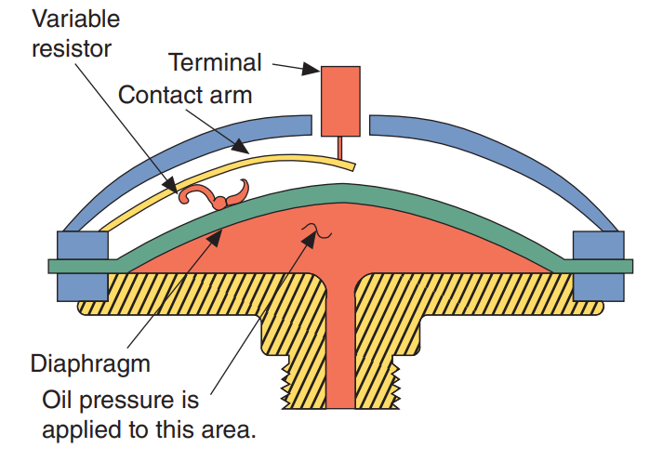
Basic Information Gauges (3 of 3)
The oil pressure gauge displays engine oil pressure.
With low oil pressure (or with the engine shut off), the oil pressure switch is open and no current flows through the gauge winding.
The needle points to low (L). With oil pressure above a specific limit, the switch closes and current flows through the gauge winding to ground.
A resistor limits current flow through the winding and ensures that the needle points to about mid-scale with normal oil pressure.
A piezoresistive sensor is threaded into an oil delivery passage in the engine.
The pressure of the oil moves a flexible diaphragm.
This movement is transferred to a contact arm that slides down the resistor.

Slide 19
Indicator and Warning Devices (1 of 2)
21.05 List and explain the function of the various indicators found on today’s vehicles.
21.06 List and explain the function of the various warning devices found on today’s vehicles.
Vehicles are equipped with several warning devices to alert the driver to problems. Most of these are safety or emissions related.
These are controlled by sending units that act as simple on/off switches. The sending units can be normally open or normally closed switches.
Warning lights notify the driver that something in the system is not functioning properly or that a situation exists that must be corrected.
Some system problem may cause the system to emit an audible sound in addition to illuminating the lamp.
Gauges and warning lights often work together to alert the driver to a problem.
Indicator lamps inform the driver that something that is normally off is now on, or vice versa.

Slide 20
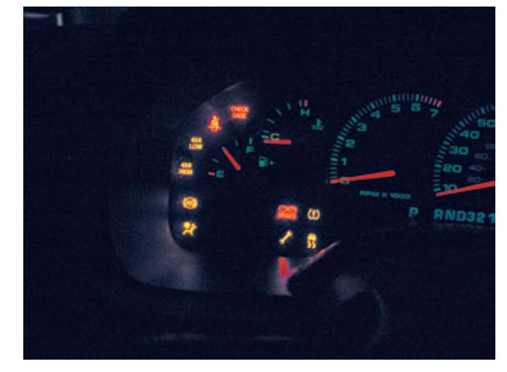
Indicator and Warning Devices (2 of 2)
Warning lights will come on briefly when the engine is first started; this is a bulb check.
It is unlikely that all of the lamps will be bad so if the lamps do not light during the bulb check, check the circuit’s fuse.
If the fuse is okay, check for voltage at the last common connection.
If there is no voltage there, follow the circuit back to the battery and check for voltage at all available points.
If there was voltage at the common connection, test each circuit branch.
Unplugging the electrical connection to the sending unit should cause the warning lamp to either light or go out, depending on whether the sending unit is normally closed or open.

Slide 21
Engine-Related Warning and Indicator Lights
Check Engine Light
  This may be also labeled as “Service Engine Soon”.
  It is primarily an emissions-related light.
Oil Pressure Light
  This lamp, represented by the oil can, is operated by an oil pressure switch located in the engine’s lubricating system.
Charge Indicator Light
  If there is something wrong with the charging system, this light comes on while the engine is running.
Check Filler Cap
  This lamp will be illuminated when the gas filler cap is not tight or off and when there may be a problem with the fuel system.

Slide 22
Safety-Related Warning and Indicator Lights (1 of 3)
Electric Power-Steering Fault Light turns on if a fault is present in the electric power steering assist system.
  Because the steering is still mechanically linked to the steering gearbox, steering control is maintained; however, power-steering assist will be reduced or absent.
The air bag readiness light lets the driver know the air bag system is working and ready to do its job.
  It lights briefly when the ignition is turned on. A malfunction in the air bag system will cause the light to stay on continuously or to flash.
Passenger or Side Air Bag Off Light Some vehicles have an indicator light that alerts the driver when the passenger side air bag or side impact air bags are disabled.
  This typically occurs when an object of insufficient weight is placed in the passenger seat. The occupant detection system in the seat recognizes that the weight is not enough to be a full-sized person and turns the air bag off.

Slide 23
Safety-Related Warning and Indicator Lights (2 of 3)
Fasten Belts Indicator is typically accompanied by a chime and will illuminate when the driver and/or passenger has not fastened the seat belt.
  The chime and lamp will stay on until the belt is buckled. When the ignition switch is in the ON position, the system is activated for about 5 seconds, whether or not the driver’s belt is buckled.
Brake Warning Light is an indication that the parking brake is engaged or there is a problem with the brake system.
  Vehicles built for Canada may have a separate warning lamp that indicates when the parking brake is applied.
Brake Fluid Level Warning Light is connected to a brake fluid level sensor in the brake fluid reservoir. If the brake fluid drops below a specified level, the sensor is activated and the light turns on while the engine is running. The same red BRAKE light is often used to indicate the parking brake is set and brake fluid level is low.

Slide 24
Safety-Related Warning and Indicator Lights (3 of 3)
If an antilock brake system fault is present, the antilock brake module grounds the indicator circuit, and the antilock light goes on.
  Vehicles built for Canada may have a different symbol on their warning lamp.
Traction/Stability Control Light is used with the ABS warning light to indicate a fault in the traction or stability control system.
  A failure of the ABS, such as from a faulty wheel speed sensor, will turn on both the ABS and traction or stability control lights. The red lamps will also be lit when the system is turned off. Yellow lamps are lit when the system is actively regulating drive torque and braking force.
Brake Pad Indicator illuminates when the sensors at the wheel brake units sense thin brake pads. The sensors are typically embedded in the pads, and when they contact the metal rotor, the warning light circuit is complete and the lamp is lit.
Lamp-Out Warning The lamp-out warning module is an electronic unit that is designed to measure small changes in voltage levels.

Slide 25
Driver Information Warning and Indicator Lights (1 of 2)
Blind Spot Detection, Back Up, and Lane Departure Warnings
  These systems may use a combination of visual alerts, such as blinking lights in the mirrors.
  These alerts are used to inform the driver that an object is detected within the range of view of the various sensors.
Low Fuel Warning
  This lamp will illuminate when the fuel level is below a quarter full. An electronic switch closes and power is applied to illuminate the lamp.
Drive Indicator
  Some four-wheel-drive vehicles have a lamp which, when lit, indicates that the vehicle is in four-wheel-drive mode of operation.

Slide 26
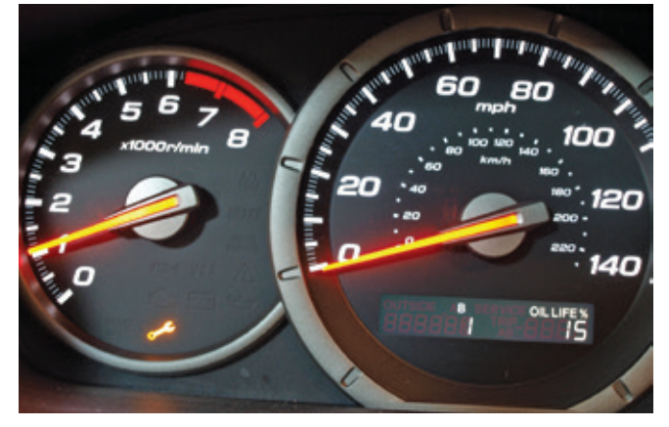
Driver Information Warning and Indicator Lights (2 of 2)
Maintenance Reminder
  This lamp turns on to alert the driver that maintenance needs to be performed on the vehicle.
  The light is controlled based on calculations that take into account mileage and the driving and operating conditions since the last service.

Slide 27
Knowledge Check (1 of 2)
True or False? The Check Engine Light is primarily an emissions-related light.

Slide 28
Knowledge Check Answer (1 of 2)
Answer: True.
The Check Engine Light may be also labeled as “Service Engine Soon” and is primarily an emissions-related light.

Slide 29
Sound Warning Devices
Various types of tone generators, including buzzers, chimes, and voice synthesizers, are used to make drivers aware of current operating conditions.
These warnings can include fasten seat belts, air bag operational, key left in ignition, door ajar, and light left on.

Slide 30
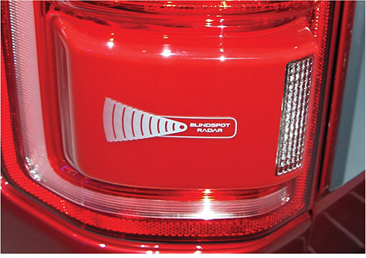
Park Distance Control (PDC) and Blind Spot Monitoring
This feature uses sensors to measure the distance the front and/or rear of the vehicle is from an object.
An audible signal changes in frequency as the vehicle gets closer to an object.
As the distance between the vehicle and object decreases, the intervals between the tones become shorter.
When the object is very close, the tone is emitted continuously.
The system uses four ultrasonic sensors at the rear and the front of the vehicle.

Slide 31
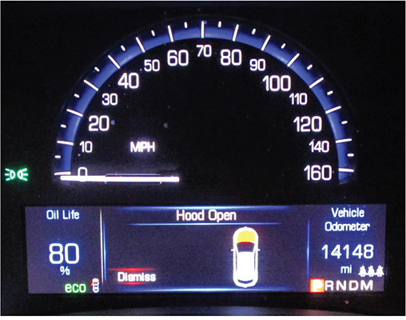
Drive Information Centers (1 of 2)
21.04 Describe the operation of the common types of gauges found in an instrument cluster.
The various gauges, warning devices, and comfort controls may be grouped together into a driver information center or instrument cluster.
This may be a simple or an all-encompassing cluster of information.
The message center keeps the driver alert of the information available.
In addition to the standard warning signals, the information center may provide other vital data as fuel range, average or instantaneous fuel economy, fuel used since reset, time, date, estimated time of arrival (ETA), distance to destination, elapsed time since rest, average car speed, and percent of oil life.

Slide 32
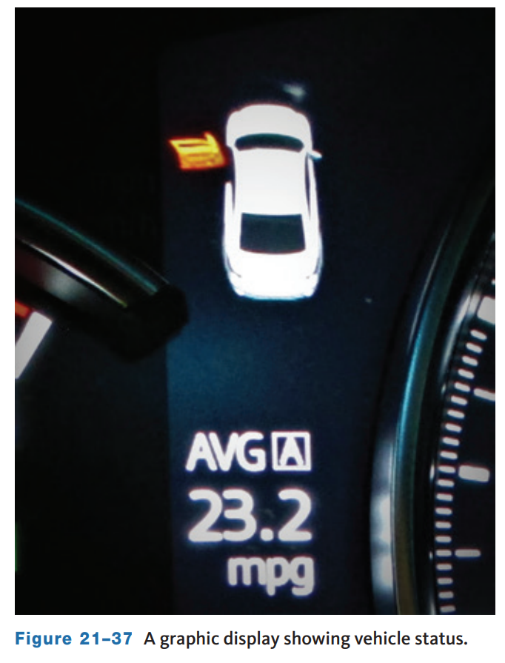
Drive Information Centers (2 of 2)
Graphic Displays
  Graphic displays are translucent drawings of the vehicle.
  They use small lamps located at various spots in the graphic.
  When a lamp is lit, the area indicated by the lamp has a problem.
  These indicators can note such things as an open trunk or a light bulb not working.

Slide 33
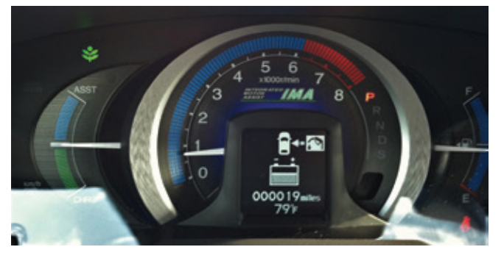
Hybrid and Electric Vehicles (1 of 3)
The instrument panel on older Honda hybrids displays the typical conditions for a gasoline engine, plus they display the operation of the hybrid (IMA) system and the car’s fuel efficiency.
The instrument panel has a meter that displays the status of the battery and IMA system.
A charge/assist indicator shows when the system’s electric motor is assisting the engine.
The amount of assist is indicated by bars.
The number of bars illuminated indicates how much assist is being provided.
This same display shows the amount of charge going to the batteries. When more bars are illuminated, the batteries are being recharged at a higher rate.

Slide 34
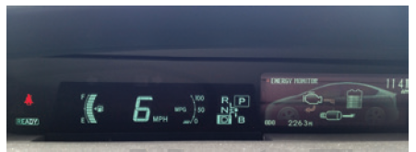
Hybrid and Electric Vehicles (2 of 3)
Most Toyota hybrids have a multi-information display in the center cluster panel.
The unique display is the energy monitor screen.
This shows the direction and path of energy flow through the system in real time.
By observing this display, drivers can alter their driving to achieve the most efficient operation for the current conditions.

Slide 35
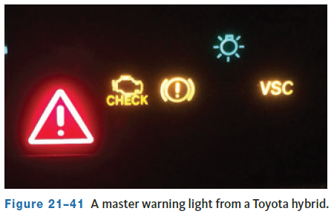
Hybrid and Electric Vehicles (3 of 3)
Here are some of the indicators that are unique to hybrids:
  “Ready” light—This lamp turns on when the ignition switch is turned to START to indicate that the car is ready to drive. The engine may or may not be running at this time, but is ready to start as needed.
  Output control warning light—This lamp turns on when the temperature of the HV battery is too high or low.
  HV battery warning light—This lamp lights when the charge of the HV battery is too low.
  Hybrid system warning light—When the HV control unit detects a problem with the motor/generators, the inverter assembly, the battery pack, or the ECU itself, this lamp will be lit. A large red triangle is often used as this type of master warning light.

Slide 36
Knowledge Check (2 of 2)
List at least three lamps that may be illuminated unique to hybrid vehicles:

Slide 37
Knowledge Check Answer (2 of 2)
Unique lamps to hybrid:
“Ready” light
Output control warning light
HV battery warning light
Hybrid system warning light

Slide 38
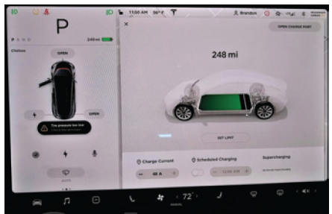
Electric Vehicle (EV) Specific Display
Plug-in hybrid and full battery electric vehicles (BEVs) will display information about charging.
This information is in regard to the main battery.
It may include information about consumption and estimated driving range.
Often, charging station information including location will be displayed.
On some vehicles such a Tesla, a one click link to navigate to the station as well as how many are available for charging at that moment included.

Slide 39
Chapter Reflection
Please take a moment to consider your understanding of instrumentation and information displays as explained in the chapter. Then respond to the following questions in one or two paragraphs. Use 150–200 words in your reflection.
Did you find any concept in this chapter difficult for you to understand? What can you do to further your understanding of these concepts?
Considering all you have learned, do you feel you are able to perform basic diagnosis and service of instrumentation and information displays in the shop? What can you do to improve?

